Slide 1
Retail Management System
DAMG 6210
Group 6:
Kshitij Prabhu
Durgesh Sakhardande
Manav Hirey
Chaitrali Katkar
Saketh Sai Mallepaddi

Slide 2
Project Overview
Our RMS is engineered to centralize retail operations, from procurement to point-of-sale, guided by the structured blueprint of our ER diagram.
The system covers inventory management, customer engagement, employee tracking, and sales analytics to optimize retail workflows.
The ER diagram detailed relationships enable efficient inventory turnover, personalized customer service, and comprehensive data insights for strategic decision-making.
Built for adaptability, our RMS embraces scalability to meet future retail trends and technologies.

Slide 3
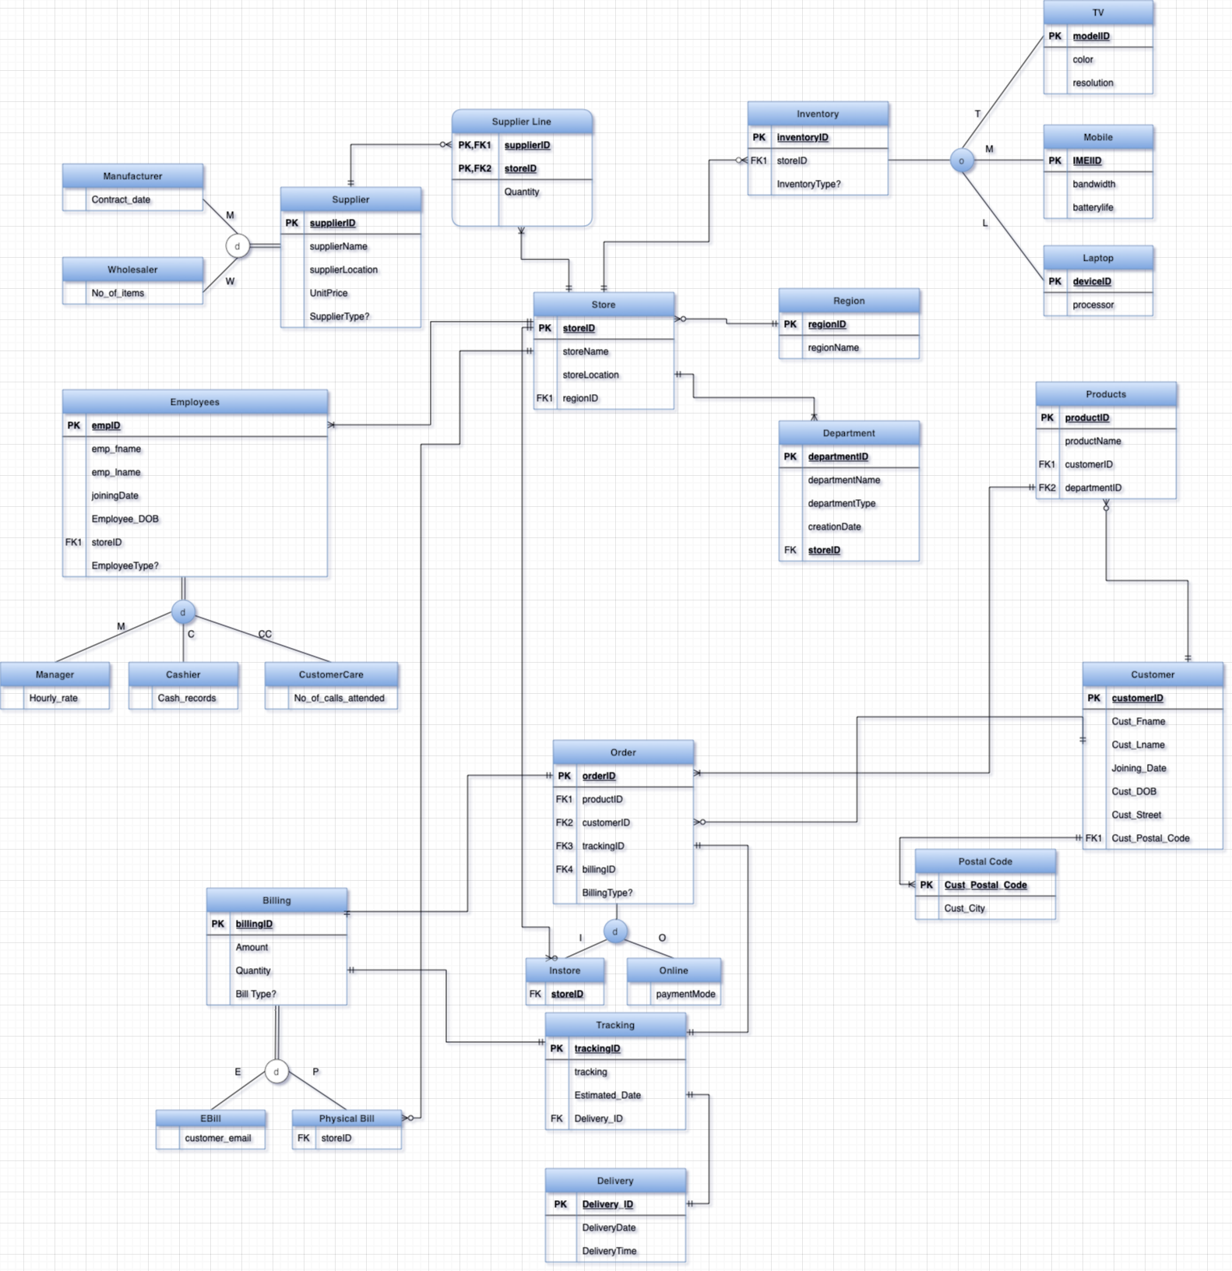

Slide 4
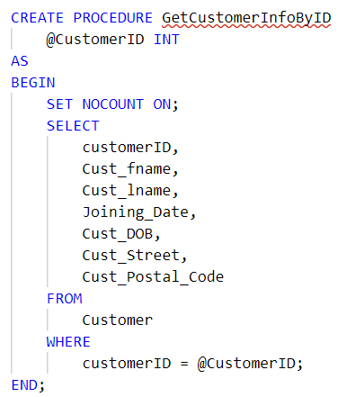
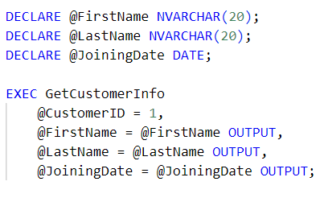

Stored Procedures

Slide 5
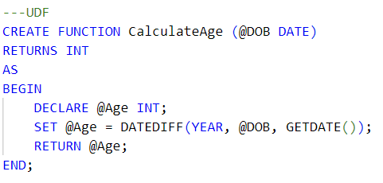
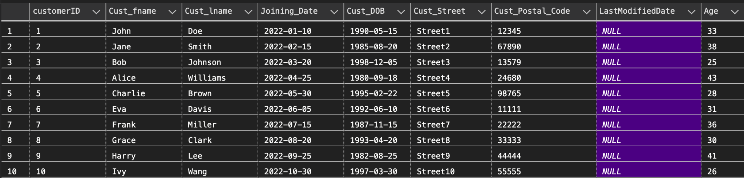
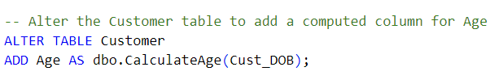
UDF

Slide 6
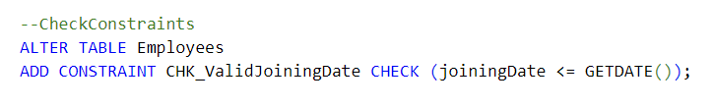
CheckConstraints

Slide 7
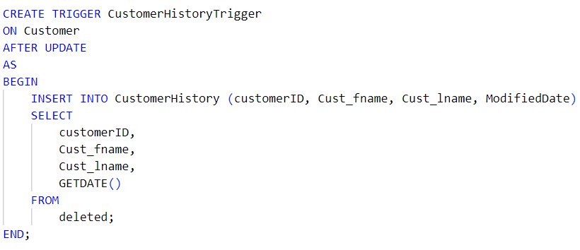
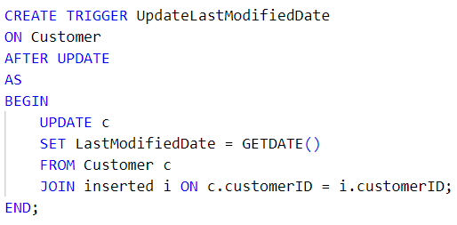
Triggers

Slide 8
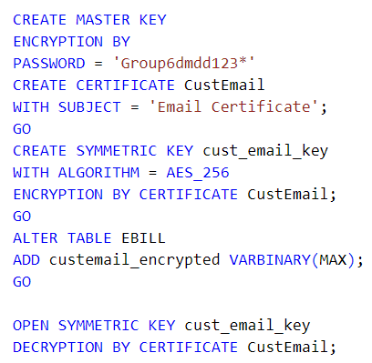
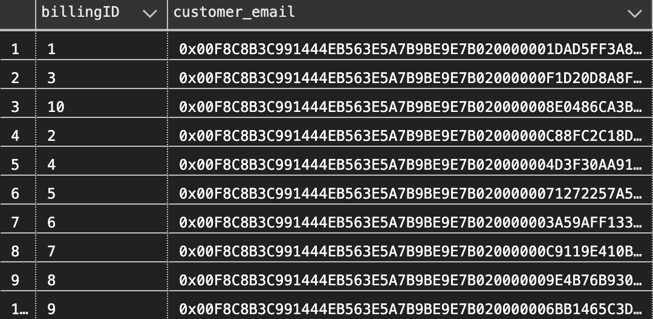
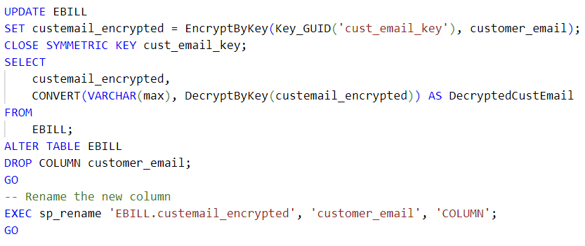
Column Encryption

Slide 9
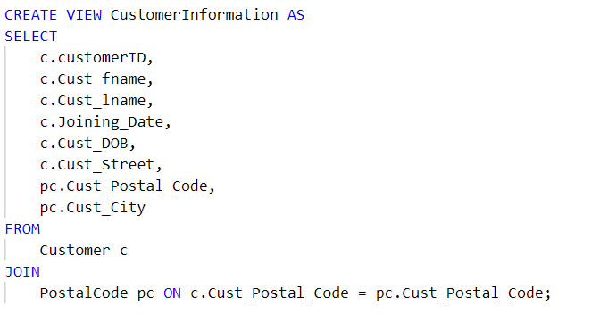
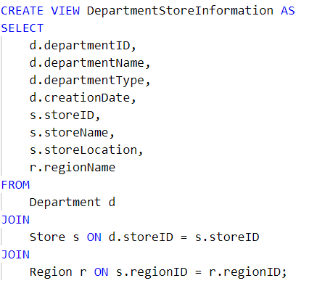
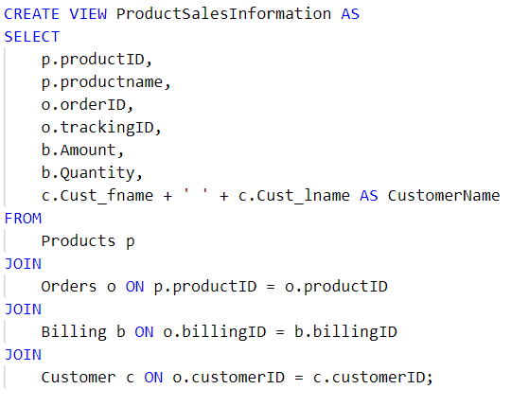
Views

Slide 10
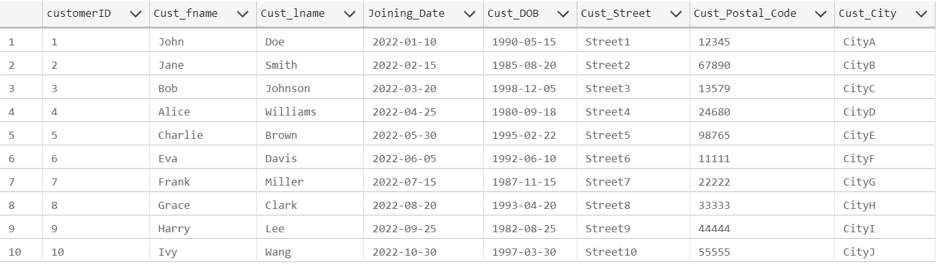
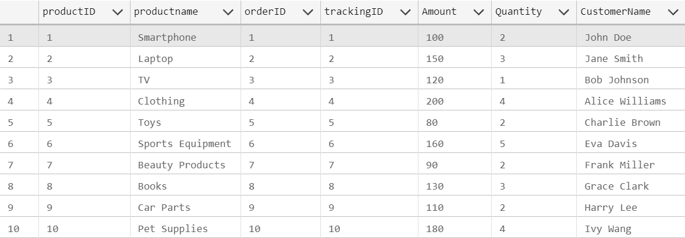
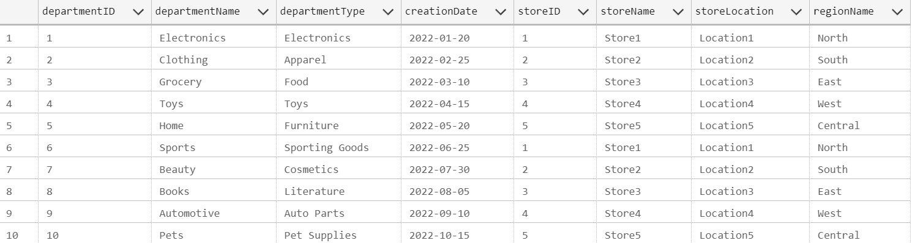
Views
SELECT * FROM CustomerInformation;
SELECT * FROM ProductSalesInformation;
SELECT * FROM DepartmentStoreInformation;

